Slide 1

GATE PREPARATION
WEBSITE
V.ANJALI (R180236)

Slide 2

CONTENT
01
INTRODUCTION
02
FEATURES
03
STEPS
04
USES
05
OUTPUT
06
CONCLUSION

Slide 3
INTRODUCTION
The Graduate Aptitude Test in Engineering (GATE). GATE is not just an exam; it's a stepping stone that opens doors to numerous opportunities in higher education, research, and esteemed engineering careers. At GATEMaster, we are committed to being your guiding light on this transformative journey.
we understand that GATE preparation requires more than just cramming formulas. It's about cultivating a deep understanding of concepts, practicing problem-solving skills, and developing effective time management strategies

Slide 4
FEATURES
Here are some essential features that a GATE preparation website could include:
Study Materials:
Well-structured notes, video lectures, and tutorials covering the entire GATE syllabus.
Subject-wise materials prepared by experienced educators and industry experts.
Solved examples and practice problems to reinforce understanding.
Mock Tests and Practice Questions:
Full-length mock tests that simulate the actual GATE exam environment.
Section-wise and topic-wise practice questions to enhance problem-solving skills.
Instant feedback and detailed solutions for better comprehension.
Performance Analysis:
Detailed analysis of mock test performances, highlighting strengths and areas for improvement.
Comparative analysis with other aspirants to gauge your standing.
Progress tracking to monitor improvement over time.

Slide 5
STEPS
1.Login
Before accessing the courses the user sholud login.If account doesnot exists one can create account by signing-up
2.Sign-up
To sign-up user should provide some basic information like email,address
,password and gender.
3.DataBase check
When user login then we check in database and confirm the user account
deatils .If the user details are validated the he/she can access courses.
4.Storing
If user sign-up then we store the details of a user in database and when
user re-visits then we check in database to login
.

Slide 6
USES
Gate preparation websites serve as valuable resources for individuals preparing for the Graduate Aptitude Test in Engineering (GATE), which is an examination used to assess the understanding of various engineering and science subjects.
1. Study Material: GATE preparation websites often provide comprehensive study material, including notes, textbooks, reference materials, and video lectures. These resources help students grasp the fundamental concepts and theories required for the exam.
2.Practice Questions: These websites offer a plethora of practice questions, both subjective and objective, covering different difficulty levels and topics. Solving these questions helps candidates assess their understanding, improve problem-solving skills, and get accustomed to the exam pattern.
3.Mock Tests: Mock tests simulate the actual GATE exam environment, allowing candidates to practice under timed conditions. This helps in building time management skills and reducing exam anxiety.

Slide 7


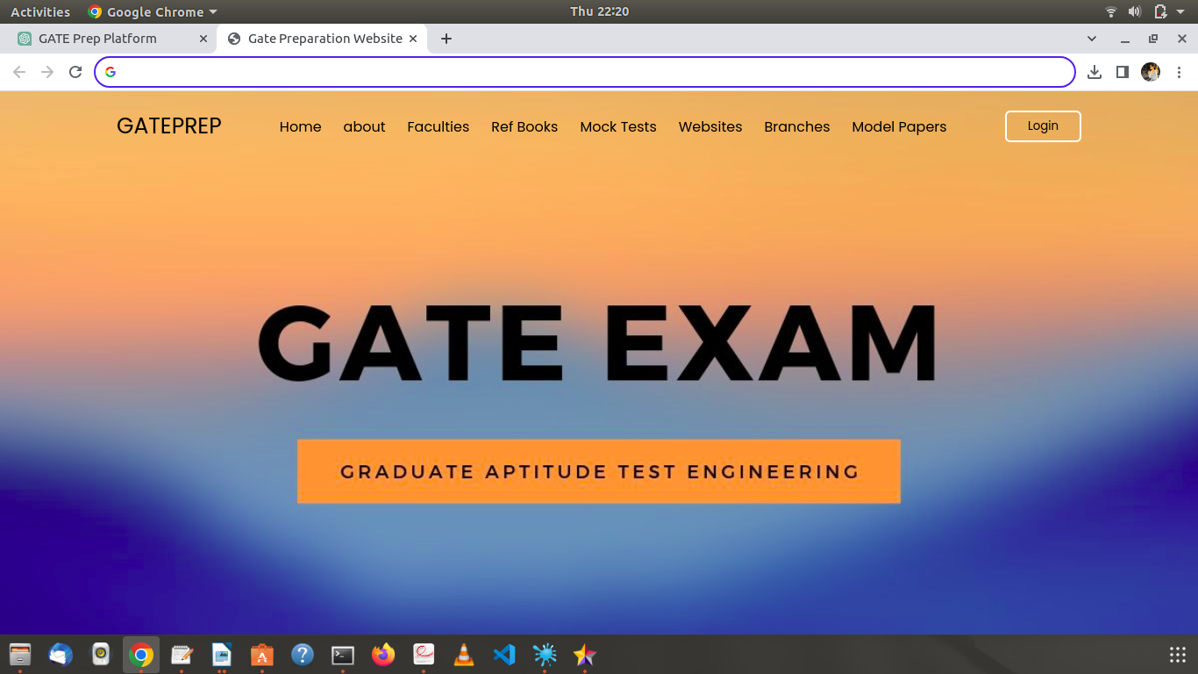

OUTPUT

Slide 8
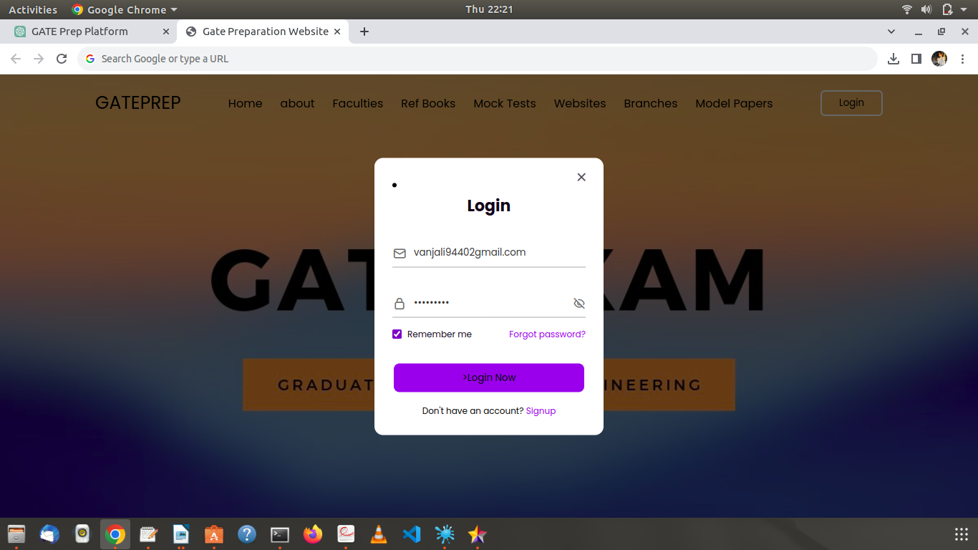

Slide 9
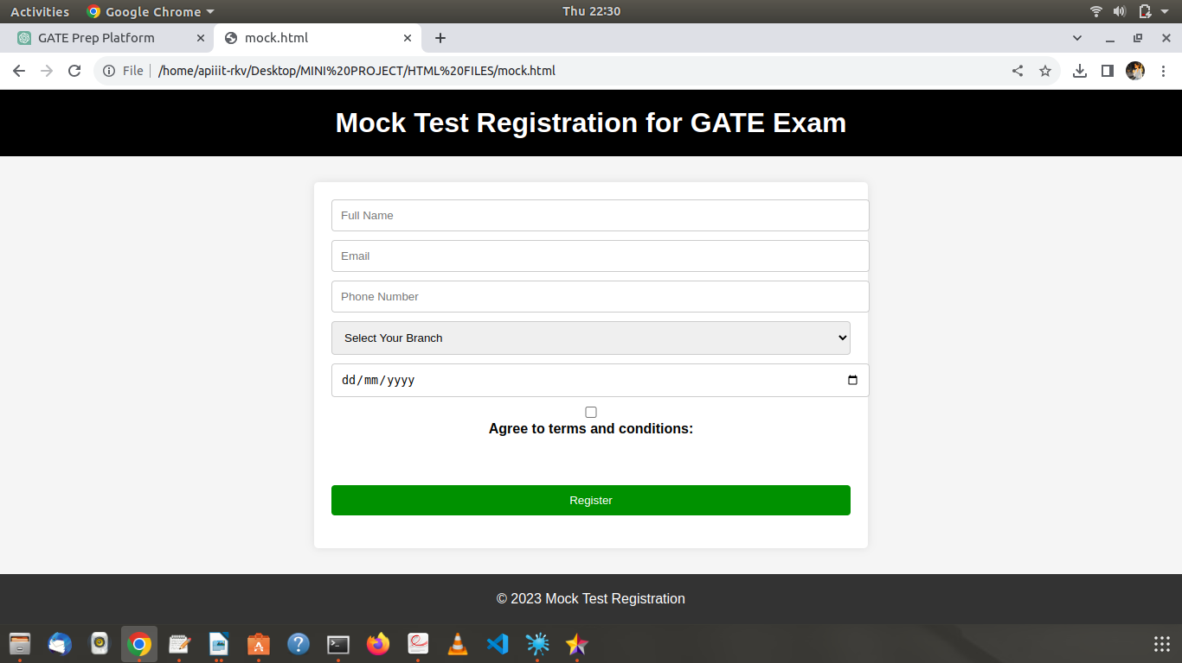

Slide 10
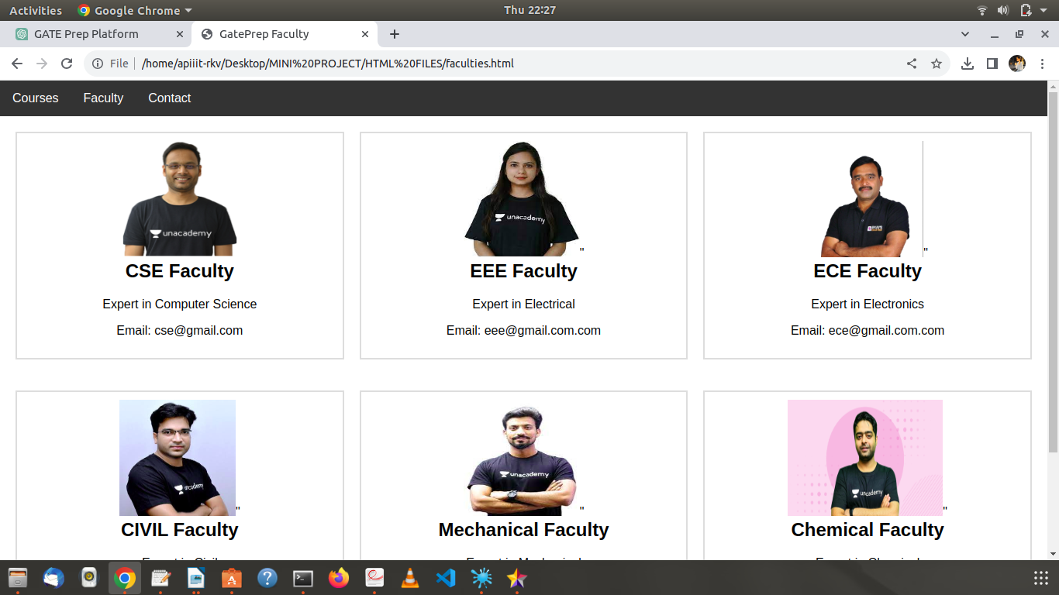

Slide 11
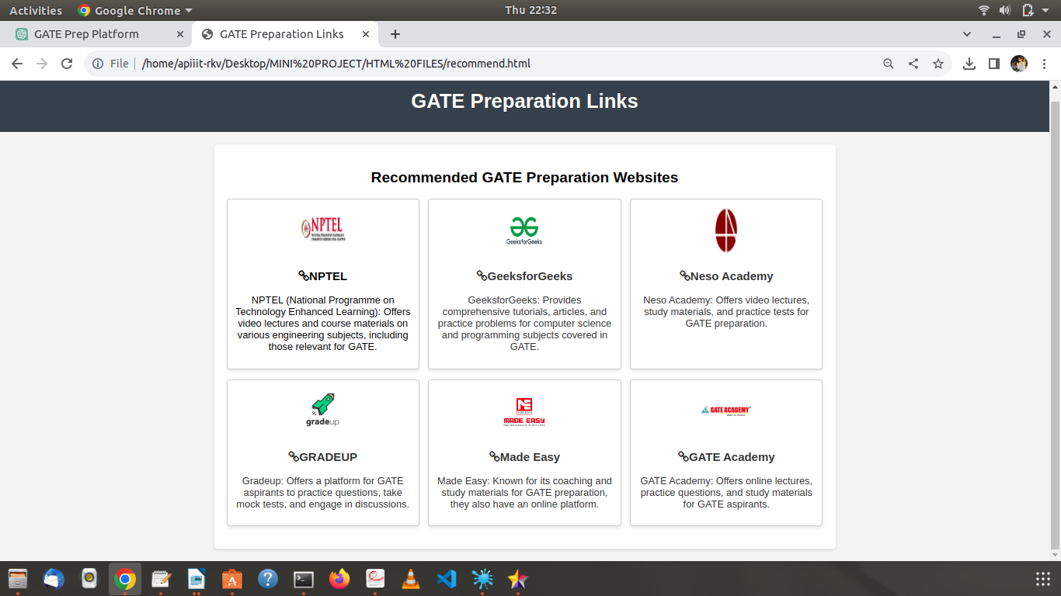

Slide 12
CONCLUSION
A well-designed GATE preparation website serves as a valuable and versatile platformfor aspiring engineers to efficiently and effectively prepare for the Graduate Aptitude Test in Engineering (GATE) exam. Such a website brings together modern technology,Interactive learning methods, and a supportive community to enhance the learning experience and improve the chances of success for GATE exam takers.
By offering a wide range of study materials, mock tests, video lectures, and
personalized learning paths, the website empowers students to master complex
engineering concepts, practice problem-solving skills, and gain a deep understanding of the exam syllabus.

Slide 13
THANK YOU

